Slide 1


Spanner & new SQL database
SE3331-1 (2022 Fall)
Xingda Wei, Yubin Xia
IPADS, Shanghai Jiao Tong University
https://www.sjtu.edu.cn

Slide 2

Review: Distributed Transaction & Replications
Caching server
Caching server
…
Caching server
Caching
Caching
Caching
Distributed caching
Database server
Database server
CDN
Users
Application #1
generate the page
Database
user, price
…
Database
user, price
Application server
Distributed database
Internet
Load
Balance
Application #2
add the order
File server
File server
File server
File:
image
File:
image
…
File:
image
Application server
…
…
Message queue
Distributed file system

Slide 3
Review of properties required by distributed systems
All or nothing atomicity
An action is atomic if happens completely or not at all
transfer(bank, a, b, amt):
bank[a] = bank[a] – amt
bank[b] = bank[b] + amt
Tools: Shadow copy, WAL
Tools: 2PC, OCC & MVCC
Before or after atomicity
Concurrent actions have the before-or-after property if their effect from the point of view of their invokers is as if the actions occurred either completely before or completely after one another
Deposit(bank, acct, amt):
bank[acct] += amt
Deposit(bank, acct, amt):
bank[acct] += amt

Slide 4
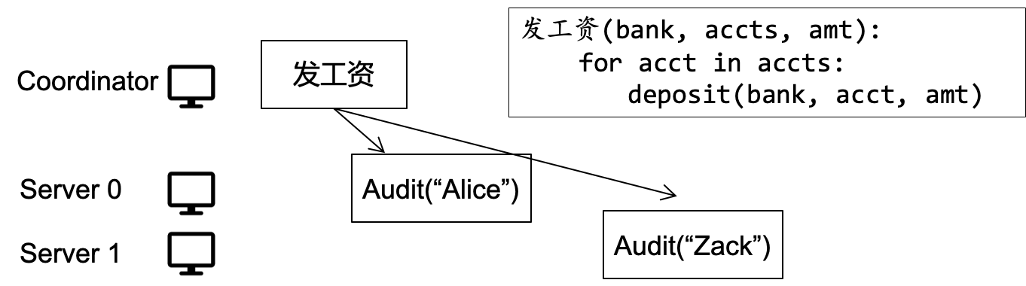
Review of properties required by distributed systems
Atomicity across multiple transactions and multiple sites
Tools: 2PC

Slide 5
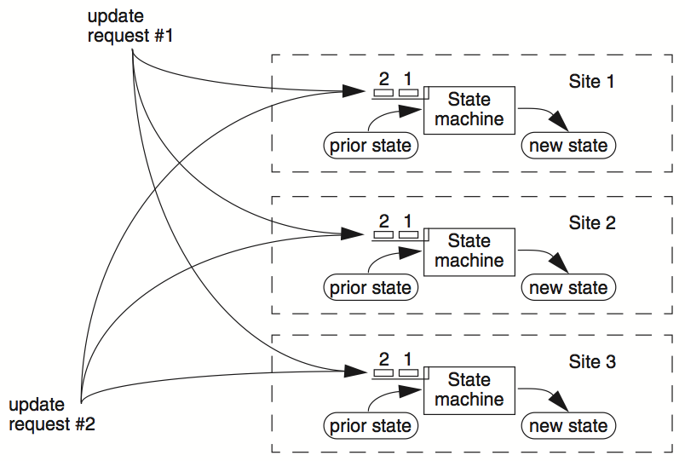
Review of properties required by distributed systems
Atomicity across multiple replications
E.g., replicated state machine
Tools: Paxos, Raft

Slide 6
Detailed distributed database study:
Google Spanner

Slide 7
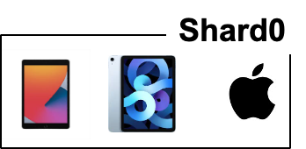


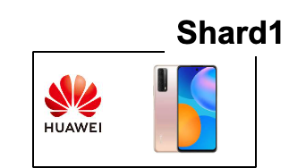




Problems faced by large-scale company
Large-scale dataset
Facebook has more than 1 billion of images uploaded weekly, Baidu stores tens of billions of web pages
Question: how to store such a large dataset?
Solution: sharding （数据切片划分）
Each shard is stored in an LSM storage
Server0
User data
Data center
Server1

Slide 8
How to shard?
A topic orthogonal to the design of Spanner
Possible way:
Hashing, node id = hash(key) % num_of_nodes
Range partitioning
E.g., coordinators record that 0-100 keys are at shard 0, etc.
A good partition need to consider many factors, e.g.,
Reduce cross shard transaction
Why? Shards are likely to span across two machines, which needs two-phase-commit for execution
We will not focus sharding in this lecture

Slide 9
Problems faced by large-scale company
Fault tolerance
Large-scale companies are built over large-scale datacenters (>10K servers)
Machine failures are particular common in large-scale datacenters
“Suppose a cluster has ultra-reliable server nodes with a stellar mean time between failures (MTBF) of 30 years (10,000 days)—a cluster of 10,000 servers will see an average of one server failure per day. ”

Slide 10
Problems faced by large-scale company
Fault tolerance
Large-scale companies are built over large-scale datacenters (>10K servers)
Machine failures are particular common in large-scale datacenters
Solution: replication
Each shard is replicated on multiple servers
Server0
Data center
Replication factor = 2
Server1

Slide 11
Question: is a replication factor of 2 ok?
Ok means can achieve single-copy consistency
Whether OK depends on the scenarios (& setup)
Under primary-backup replication, it is ok
We have a view server
Under Paxos & Raft, it’s not! (no majority)
Question 2: Is rep-factor = 2 within a single datacenter ok?
Server0
Data center
Replication factor = 2
Server1

Slide 12

Geo-replicated datacenters
e.g., The locations of Alibaba datacenters
What can go wrong if we only replicate the data only within one datacenter?
Source: https://www.alibabacloud.com/zh/global-locations

Slide 13
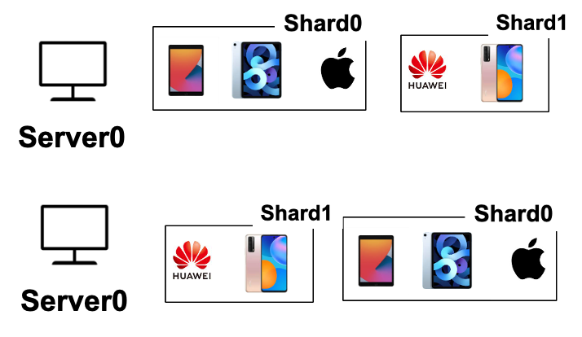
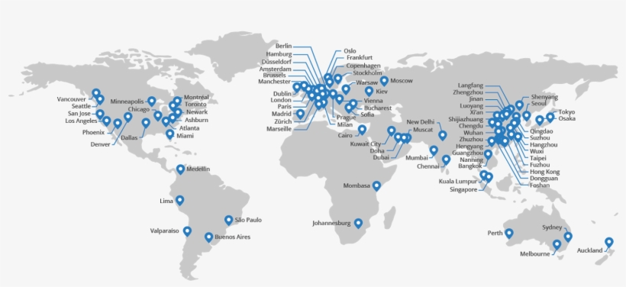

Replication within a DC is insufficient
A single datacenter (DC) can fail due to natural disasters
A DC cannot serve requests well (in low latency) across the planet
DC1
Users from china will suffer from long latency
DC in the US

Slide 14
Spanner further replicates the data across datacenters
Data sharded & replicated over many machines & datacenters
Tolerate machine failures across datacenters & lower request latency
User data
Server1
Server1
DC0
DC1
Data centers
Users from china can query DC at china for lower latency
Notes:
How to shard? Range or hash

Slide 15

Replications causes consistency problem
Could not achieve single-copy consistency if allow client arbitrary reads/writes
E.g., consistency among replicas
The same data is replicated on machines at different datacenter(DC)s
?
Request 1
Request 2
Bob.acct = 100$
Print(bob.acct)
DC0
Bob.acct=0$
DC0
Bob.acct=100$
DC0
Bob.acct=100$
Time
DC1
Bob.acct=0$
DC1
Bob.acct=0$
DC1
Bob.acct=0$

Slide 16
Solution: Paxos for single-copy consistency
Spanner uses Multi-Paxos w/ leaders to abstract the replicated shard
On the developer’s perspective, a shard w/ replication can be viewed as a single-shard (single-copy consistency)
Though its content is actually replicated over machines across datacenters
Physical view
Logical view
+Paxos

Slide 17
2-phase commit + 2-phase locking
With Paxos, multiple replicas of a shard can be viewed as one
E.g., the developer sees an X, but X is actually replicated multiple times
However, Paxos is insufficient
A user request (TX) can touch multiple shards
How to coordinate these accesses?
Using two-phase locking for before-or-after atomicity & two-phase commit for multi-site atomicity
x
tx.begin()
x = x + 1
y = y + 1
tx.end()
Y

Slide 18
Big picture of Spanner
How to scale to a larger dataset?
Sharding
How to tolerate failures across machines & datacenters?
Replicated state machine w/ Paxos
Can also use raft (e.g., TiDB)
How to execute read-write transaction to ensure before-or-after atomicity and multi-site atomicity?
2PL + 2PC

Slide 19

Execution flow of read-write transaction(TX)
Read-write TX:
A TX that both reads and writes the data
tx.begin()
x = x + 1
y = y + 1
tx.end()
Client
Notes:
// what is a read-write TX
Execution flow

Slide 20
Execution flow of read-write transaction(TX)
Read-write TX:
A TX that both reads and writes the data
tx.begin()
x = x + 1
y = y + 1
tx.end()
DC0
DC1
x
X
Y
Y
Client
X,Y are sharded on two servers
Notes:
// what is a read-write TX
Execution flow

Slide 21
Execution flow of read-write transaction(TX)
Each shard is replicated
The run PAXOS to behavior as a single (logical) shard
tx.begin()
x = x + 1
y = y + 1
tx.end()
DC0
DC1
x
X
PAXOS
Y
Y
PAXOS
Client
Each shard is replicated on multiple DCs
Notes:
Omit local replication for simplicity

Slide 22
Execution flow of read-write transaction(TX)
Each shard is replicated w/ PAXOS
A replica is selected leader to simplify execution (no Raft introduced then)
tx.begin()
x = x + 1
y = y + 1
tx.end()
DC0
DC1
x
X
PAXOS
Y
Y
PAXOS
Leader will execute request
Start a PAXOS proposal accordingly
Client
Notes:
The leader is responsible for accepting client requests and managing the replication of the log to other servers. The data flows only in one direction: from leader to other servers.
Proposal & learned
Similar to the RAFT leader
Hold the latest value (w/o failure)

Slide 23
Execution flow of read-write transaction(TX)
Spanner uses standard 2PC & 2PL for executing read-write TX
Two-phase commit & two-phase locking
tx.begin()
x = x + 1
y = y + 1
tx.end()
DC0
DC1
x
X
PAXOS
Y
Y
PAXOS
Client

Slide 24

Execution flow of read-write transaction(TX)
Upon read, the leader will return the latest value of data
Also hold the lock on it (2PL)
tx.begin()
x = x + 1
y = y + 1
tx.end()
DC0
DC1
x
X
PAXOS
Rx
Y
Y
PAXOS
Client sends each read to Paxos leader of relevant shard, lock the record & do the latest value
Client
Notes:
Read locks are not replicated via Paxos, so leader failure -> abort.

Slide 25
Execution flow of read-write transaction(TX)
The write will be buffered at local client
They will be written back via 2PC at the TX’s commit time
tx.begin()
x = x + 1
y = y + 1
tx.end()
DC0
DC1
write
x
X
PAXOS
Rx
Y
Y
PAXOS
在这里client直接与x对应的leader通信是可能存在问题的，比如x-leader可能在中途发生crash，这种情况下，x的lock即使被获取了也会失效，这时候就需要进行lock的备份，而在2PL中将这个过程推迟到了commit-phase，这样可以防止性能变得很差。
Client

Slide 26
Execution flow of read-write transaction(TX)
Commit will use 2PC to write all the updates back
It will choose a shard leader as the coordinator leader
tx.begin()
x = x + 1
y = y + 1
tx.end()
DC0
DC1
x
X
PAXOS
Rx
Y
Y
PAXOS
Client
Ry

Slide 27
Execution flow of read-write transaction(TX)
The coordinator uses its PAXOS group to replicate the TX states
Why? Otherwise, the 2PC may fail if the coordinator crashes!
tx.begin()
x = x + 1
y = y + 1
tx.end()
DC0
DC1
x
X
PAXOS
Rx
Y
Y
PAXOS
Select as coordinator leader
w/ the update values
为何不能直接选择client作为coordinator？因为client是可能crash的，而在2PC中若发生crash则会使得commit失败，所以一般选择具有paxos机制的leader之一作为coordinator
Client
Ry
Notes:
为什么client单独没法做leader？

Slide 28
Execution flow of read-write transaction(TX)
The coordinator leader will send the update values to the host shard leader
And each shard leader execute the prepare with PAXOS (including locking the write-set, and replicates its locks to tolerate leader failure)
tx.begin()
x = x + 1
y = y + 1
tx.end()
DC0
DC1
x
X
PAXOS
Prepare
Rx
Y
Y
PAXOS
Prepare
Select as coordinator leader
w/ the update values
spanner中的2PL只有leader会在开始时刻拿锁，并在准备commit的时刻(prepare stage)将其同步给其他的server，这样可以对于leader-crash进行容错
Client
Ry

Slide 29
Execution flow of read-write transaction(TX)
If all shard leader returns the Yes to the coordinator leader
The coordinator log the commit decision (via PAXOS) & commit others
tx.begin()
x = x + 1
y = y + 1
tx.end()
DC0
DC1
x
Commit
X
PAXOS
Commit
Rx
Y
Y
PAXOS
Commit
Select as coordinator leader
w/ the update values
Yes: logs a commit record through Paxos
Client
Ry
Commit: update & release the lock
Notes:
Lock is replicated only at the prepare phase to improve the performance

Slide 30
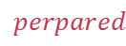
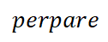
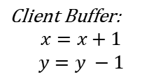
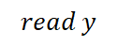
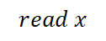
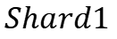
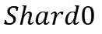
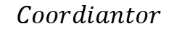
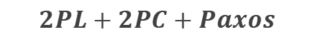

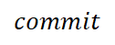
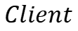
Read-write TX: put it all together
Multiple physical nodes
backed by PAXOS
$$2PL+2PC+Paxos$$
$$Client$$
$$read x$$
$$Shard0$$
$$Shard1$$
$$read y$$
Client Buffer:
$$x=x+1$$
$$y=y −1$$
$$Coordiantor$$
$$perpare$$
$$perpared$$
$$perpare$$
$$perpared$$
$$commit$$
$$applied$$
$$commit$$
$$applied$$
Note: we skip the network RTTs of Paxos
Notes:
Prepared: get the lock, record 2PC state and Paxos state
Applied: release the lock
Prepare + Commit both require Paxos

Slide 31
Read-write TX: put it together
Spanner’s read-write TX gives a strong abstraction to the user
A single-thread “machine”(类似于paxos实现的single-copy consistency) that never fails (even tolerate natural disasters)
The “machine” has “unlimited” storage capacity(借助于分布式)
As long as the machines in the datacenters have enough capacity to store the data
But, what are the costs?
性能较差，原因之一就是需要大量的网络通信来实现consistency。

Slide 32
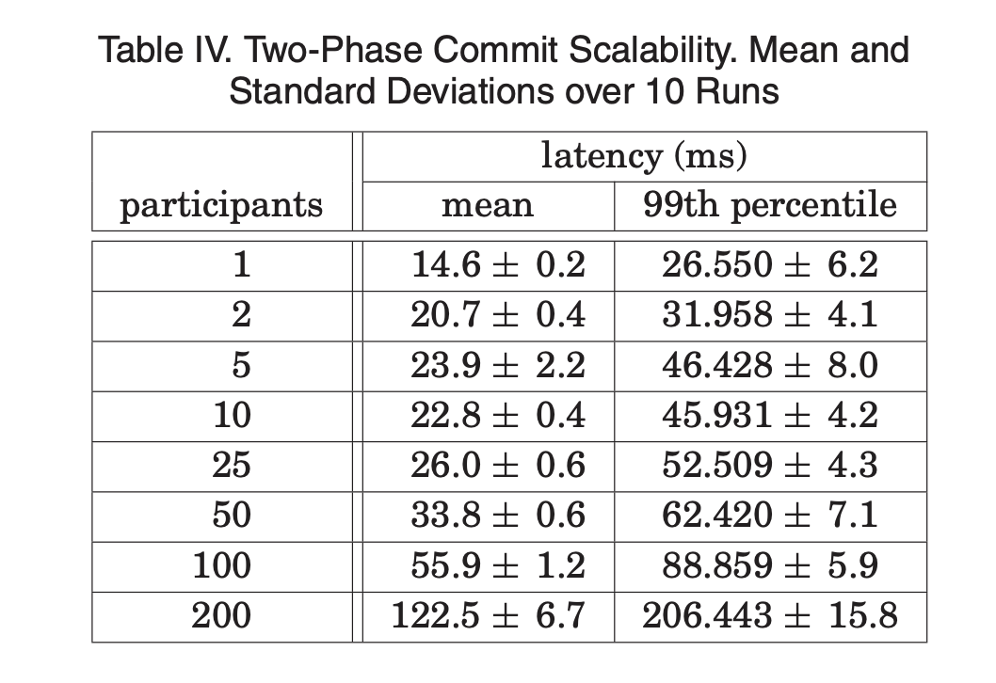
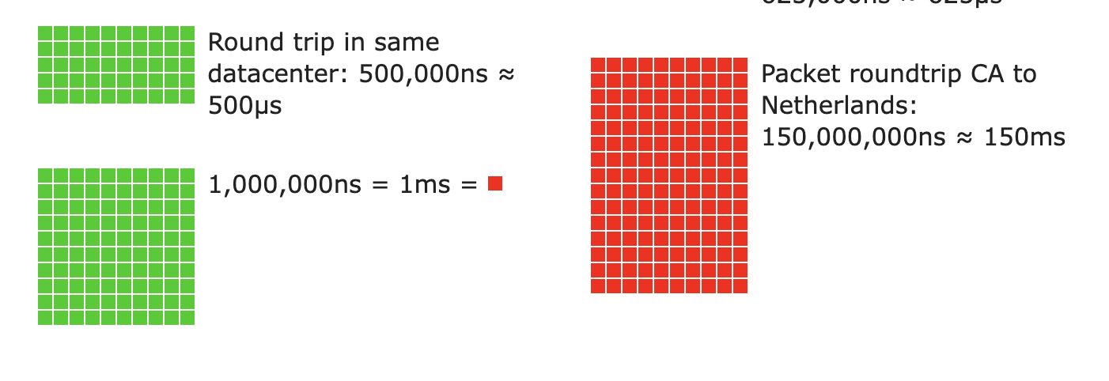
Read-write TX of Spanner so far
Techniques: 2PL & 2PC & Paxos
Not optimized– Spanner finds writes are infrequent at Google
Maybe slow: many messages sent between machines
Also, across datacenters!
Source: https://colin-scott.github.io/personal_website/research/interactive_latency.html
Notes:
Data: 2PC through three regions

Slide 33

What about read-only TX?
Problem: read-only TXs are massive faced by Google
Each read-only TX may touch many datasets
Drawbacks of 2PL
May possibly lock the items very long
Solution
Multi-version concurrency control

Slide 34
Review: Multi-version Concurrency Control
Each data item has multiple versions
When accessing different versions of data, probably no conflict!
Key (high-level) idea
Writes don’t overwrite the original data
Instead, writes install new versions of data
Reads read from a "snapshot" of data
Benefits: no lock or validation during TX’s execution
bankA: 100, ver: 12, pre:xx
bankA: 100
bankA: 200, ver: 10, pre:xx
Single-version
Multi-version

Slide 35
Review: Snapshot Isolation
A popular multi-version concurrency control (MVCC) scheme
Transactions will get start and commit timestamp
Use start timestamp to find the snapshot to read
Use commit timestamp to install new versions
Transactions:
WRITEs a local buffer (similar to OCC)
READs a “snapshot” of entire data image
COMMIT only if no write-write conflict
Install new versions of data

Slide 36
Review: Snapshot Isolation Implementation
T is assigned a commit timestamp T.cts
System checks all data within T.wset, if T.sts < X.cts < T.cts, then abort T
Update all data within T.wset with T.cts
T is assigned a start timestamp T.sts
T
START
READ(X)
WRITE(X)
COMMIT
Time
T reads the biggest version of X(i), such that X(i).cts <= T.sts
T buffers writes to X and adds X to its write-set, T.wset += {X}

Slide 37
Snapshot is not suitable for Spanner: non-serializable!
Snapshot isolation (SI) differs from serializability due to one anomaly that is possible under SI but not under serializability.
Describe the anomaly and also give a concrete application for which the anomaly is undesirable.
T1
S
R(X)
W(Y)
C
R(X) = X₀
W(Y) = Y₁
T2
S
R(Y)
W(X)
C
R(Y) = Y₀
W(X) = X₁
Possible Serial Order
X₀
X₁
T1
T2
Y₀
Y₁
T2
T1

Slide 38
Idea: use 2PL for read-write TX, MVCC for read-only TX
Still use 2PL for read-write TX
The execution of TXs is always serializable!
Ensure that the final state of Spanner is always correct
Use MVCC to exeute the read-only TX
Read-only TX no-longer to acquire locks for the execution
Note that similar technique also applies to OCC
E.g., we can use OCC for read-write TX, and MVCC for read-only TX
Out of the scope of this course

Slide 39
MV-2PL: read-write TX (w/o 2PC & Paxos for simplicity)
Acquire all the write locks, T is assigned a commit timestamp T.cts
update all data within T.wset with T.cts
Release all the locks
T
START
READ(X)
WRITE(X)
COMMIT
Time
Acquire the read lock on X and then
read the latest
Writes locally

Slide 40
MV-2PL: read-only TX
T is assigned a start timestamp T.sts
T
START
READ(X)
Time
T reads the biggest version of X(i), such that X(i).cts <= T.sts

Slide 41
Challenge: missing the update
T1:
Print(A+B)
T2:
B = 2
A = 3
Time
T1
T2
A: A₀
1
Commit_time = time()
B: B₀
Write(B, B₁)
A: A₀
2
start_time = time()
B: B₁ B₀
Read(A) = A₀
A: A₀
Read(B) = B₁
B: B₁ B₀
A: A₁ A₀
Write(A, A₁)
B: B₁ B₀
Missing the updates!

Slide 42
Atomic scope of the operations in MV-2PL
Acquire all the write locks, T is assigned a commit timestamp T.cts
update all data within T.wset with T.cts
Release all the locks
Acquire the read lock on X and then
read the latest
T_{rw}
START
READ(X)
WRITE(X)
COMMIT
Time
Write locally
T is assigned a start timestamp T.sts
T_{RO}
START
READ(X)
Time
T reads the biggest version of X(i), such that X(i).cts <= T.sts

Slide 43
Achieves the atomicity w/ waiting for the lock
Commit(tx):
// assume the records have been locked via 2PL
let commit_ts = time()
for record in tx.write_set:
record.insert_new_version(commit_ts, ...)
// release all the locks like 2PL
Get(tx, record):
while record.is_locked()://与之前的OCC对于read-set的处理一致，只不过这时候的read/write set位于两个不同的事务中
pass
for version,value in record.sort_version_in_decreasing():
if version <= tx.start_time:
return value

Slide 44
Example revisit
T1:
Print(A+B)
T2:
B = 2
A = 3
What if we lock after the commit_time?
Time
T1
T2
不能在commit-time之后上锁，因为commit了实际上就可以读取新的数据了，但是acquire lock与commit-time-set之间是非原子的，因而可能被另外一个read-TX读取到了stale-data而导致inconsistency
Lock A, B
A: A₀
1
Commit_time = time()
B: B₀
Write(B, B₁)
Unlock B
A: A₀
2
time()
B: B₁ B₀
Read(A) = ?
A: A₀
Cannot read! Because A is locked!
B: B₁ B₀
A: A₁ A₀
Write(A, A₁)
B: B₁ B₀
Unlock A
Read(A) = A₁
Read(B) = B₁

Slide 45
Question remains: how do we assign the time to TXs?
Timestamp of start & commit should be assigned in an increasing order
E.g., global counters with atomic increase
Note: read-only TX does not necessary increase the time
Example implementation: global counter (on a single machine)
u64 global_time; // initial 0
tx_begin(tx) { // read-only
tx.global_time = READ(global_time);
...
}
tx_commit(tx) { // read-write
tx.commit_time = FAA(global_time);
...
}
struct TX {
u64 start_time;
u64 commit_time;
set<...> write_set;
...
}

Slide 46
Question: is global counter suitable for Spanner’s use case?

Slide 47


Global time is inefficient for Spanner’s use case
Performance overhead
1. Extra latency overhead
2. Scalability bottleneck
Question: can we avoid reading the global counter?
Possible when considering the read-only TX
问题：如果每一次都要去维护global-counter，就需要去和存储这个counter的DC通信，而这时性能很差的行为，因为可能会有明显的overhead。
User data
Global counter
DC0
DC1
2
1

Slide 48
Cache the time locally to avoid querying the global counter
Observation: the read-only TX can read a stale timestamp
E.g., not reading from the latest global counter
Still correct
TX only reads from a (possible) stale snapshot

Slide 49
Cache global counter to avoid frequently reads
Cache start timestamp for the read-only TX
The read-only TX no longer needs to do the FAA(fetch-and-add) all the time
Note: here FAA maybe implemented as a remote procedure call
To the server that stores the global counter
u64 global_time; // initial 0
tx_begin(tx) {
if cached_time.is_none():
tx.cached_time= Some(READ(global_time));
tx.start_time = tx.cached_time.unwrap()
...
}
struct TX {
u64 start_time;
u64 commit_time;
Option<u64> cached_time;
set<...> write_set;
...
}

Slide 50
Example revisit w/ cached time
T1:
Print(A+B)
T2:
B = 2
A = 3
Global counter
(initial 2)
T1 (cached_time = 0)
T2
A: A₁ A₀
B: B₁ B₀
1
3
Commit_time = FAA(G)
Write(B, B₃)
A: A₃ A₁ A₀
Write(A, A₃)
B: B₃ B₁ B₀
Start_time = 0 // cached
Read(A) = A₀
A: A₃ A₁ A₀
Read(B) = B₀
B: B₃ B₁ B₀

Slide 51


Drawbacks of cached time
No freshness(最新的,这里应该还有”正确的”的语义) guarantees
i.e., no external consistency
External consistency is the most desirable for the programmer
Simplified definition: If T1 completes before T2 starts, T2 must see T1's writes.
通俗来说即使逻辑上后发生的事务一定会看到先发生的事务的结果(新的write)。
Should be 100!
T1
T2
Bob.acct = 100$
Print(bob.acct)
Time
John
Bob

Slide 52
Drawbacks of cached time
No freshness guarantees
i.e., no external consistency
Read-write TX still need to acquire the global counter
Extra latency to communicate with the server that stores the global time
Possible performance bottleneck

Slide 53
Challenge of the timing in MVCC so far
Time needs synchronization for external consistency
If a read-write TX has decided to commit, then a read-only TX starts, then must ensure:
Time_{read-only} >= Time_{read-write}
Global counter trivially satisfies this requirement
But requires a centralized time server not suitable for geo-replicated databases
Can we use the physical clock of the machines?

Slide 54

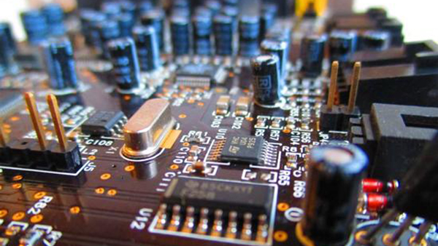
Timing: a key building block in distributed systems
Time is used by many distributed systems
e.g., cache expiration (DNS, HTTP), file synchronizers, Kerberos, ..
time intervals: how long did some operation take?
calendar time: what time/date did some event happen at?
ordering of events: in what order did some events happen?
How computer measure times?
Computer has a reasonably-fixed-frequency oscillator
E.g., quartz crystal
Represent time interval as a count of oscillator's cycles
time period = count / frequency
e.g., with a 1MHz oscillator, 1000 cycles means 1msec

Slide 55
Time Measuring
What happens when turn off the computer?
"Real-Time Clock" (RTC) chip remains powered, with battery / capacitor
Stores current calendar time, has an oscillator that increments periodically
Maintaining accurate time
Accuracy: for calendar time, need to set the clock correctly at some point
Precision: need to know oscillator frequency (drift due to age, temp, etc.)

Slide 56
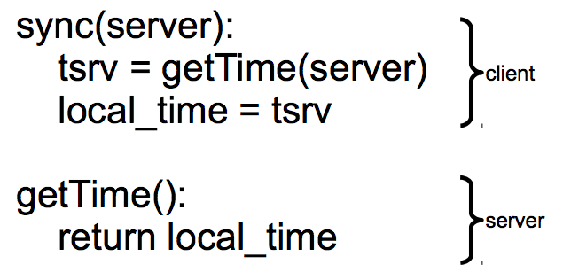
Challenge: clock synchronization
It’s hard to synchronize different machine’s clocks
the quartz clock drifts, depends on the temperature of the machine
e.g., Google assumes 17 seconds drifts assuming clocks are synchronized once per day
Common approach: synchronizing clock with NTP
Query server's time, adjust local time accordingly

Slide 57
Sync clock with NTP
Need to consider network latency
Simple estimate: RTT(round-trip time)/2
When does this fail to work well?
Asymmetric routes, with different latency in each direction
Queuing delay, unlikely to be symmetric even for symmetric routes
Busy server might take a long time to process client's request
Can use repeated queries to average out (or estimate variance) for second two
tsrv
Server
delay
Client
tbegin
tend

Slide 58
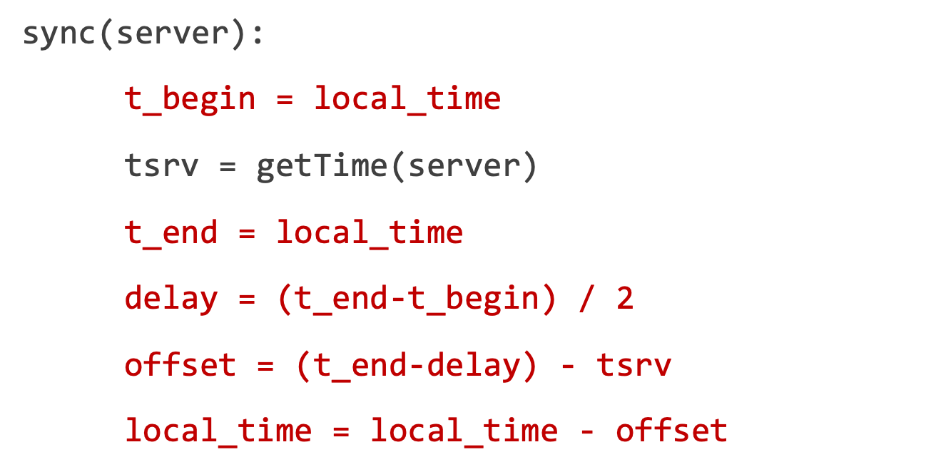
Sync clock with NTP: Estimating Network Latency
What if a computer's clock is too fast
E.g., 5 seconds ahead
Naive plan: reset it to the correct time
Can break time intervals being measured (e.g., negative interval)
Can break ordering (e.g., older files were created in the future)
"make" is particularly prone to these errors
Principle: time never goes backwards
Idea: temporarily slow down or speed up the clock
Typically, cannot adjust oscillator (fixed hardware)
Adjust oscillator frequency estimate, so counter advances faster / slower
tsrv
Server
delay
Client
tbegin
tend

Slide 59
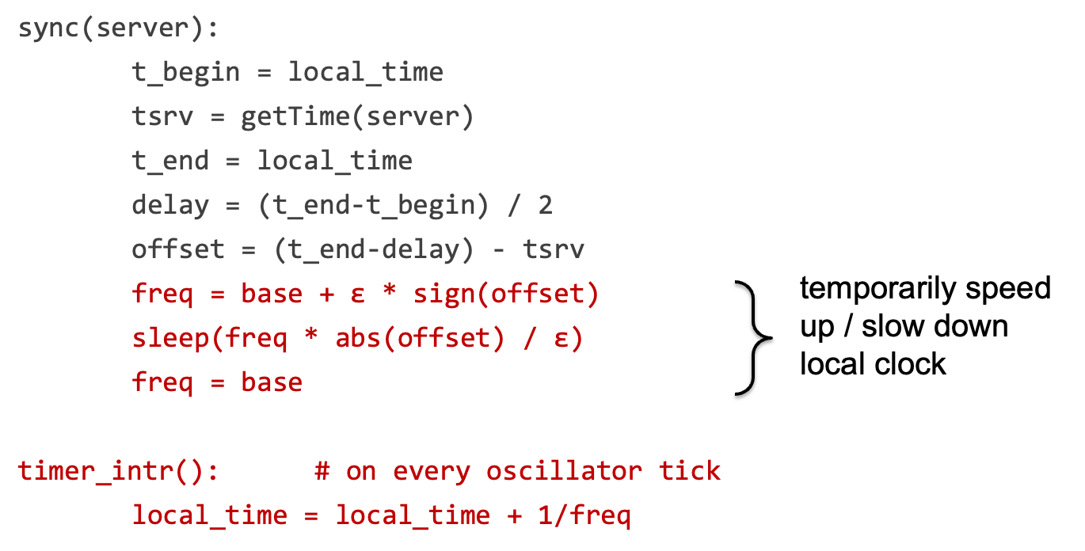
Sync clock with NTP: Estimating Network Latency
tsrv
Server
delay
Client
tbegin
tend

Slide 60
Can NTP + Physical time used for MVCC?
No bounds on the clocks between client & time server
The time of server & client is only roughly similar !
How to compare two roughly correct clock?
No way
Google’s TrueTime
Return the exact bound that the time server’s time can be

Slide 61
TrueTime API of Spanner
TrueTime returns a time interval instead of a single point of time
The interval is a bound. i.e., the time of the time server must be in this bound
The interval is the physical time. i.e., familiar to the user
struct timeval {
time_t tv_sec; suseconds_t tv_usec;
};
struct time_interval{
timeval Lower;
timeval Upper;
};
int gettimeofday(struct timeval *restrict tv, ...)
int get_truetime(time_interval *interval);
// Server timeval must be in [L,U]
Linux Time API
TrueTime API (Simplified)

Slide 62
Power of TrueTime API (return [L,U])
Used to implement external consistency
If a read-write TX has decided to commit, then:
Time_{read-only} >= Time_{read-write}
How to achieve this?
Commit wait for read-write TX: after acquire the commit timestamp, the coordinator wait until (U – L) and uses U as Time_{read-write}
这里需要等待U-L的时间是在确保commit的时候新的事务在读取的数据一定是已经提交过的新的数据(没有commit的时候TS未更新)
Commit wait done, server.time1 >= U1
Real time
Read-write TX
L1
U1
1
Note! During the interval, the TX is not committed
Get commit time-stamp

Slide 63
Power of TrueTime API (return [L,U])
Used to implement external consistency
If a read-write TX has decided to commit, then:
Time_{read-only} >= Time_{read-write}
How to achieve this?
Commit wait for read-write TX: after acquire the commit timestamp, the coordinator wait until (U – L) and U1 as Time_{read-write}
For read-only TX, simply uses U as the read timestamp (read可以不考虑commit)
Commit wait done, server.time1 >= U1
Real time
Read-write TX
L1
U1
1
2
Read-only TX
L2
U2
Get read timestamp, U2 >= server.time2

Slide 64
Power of TrueTime API (return [L,U])
关于为何不能使用L1作为TS：
因为TS的选择要保证external consistency，同时还要保证read-write-TX的逻辑顺序。而若选择L1，则若一个read-write-TX发生在L1之前，却在L1之后才结束，则其可能会读取到stale-data(因为L1是事务已经开始会认为本来的旧数据就是新数据)
Used to implement external consistency
If a read-write TX has decided to commit, then:
Time_{read-only} >= Time_{read-write}
Correctness
Time_{read-write} (U1) <= server.time1 <= server.time2 <= U2 (Time_{read-only})
Question: why not using L1 as the timestamp of the read-write TX?
Commit wait done, server.time1 >= U1
Real time
Read-write TX
L1
U1
1
2
Read-only TX
L2
U2
Get read timestamp, U2 >= server.time2

Slide 65
What if no wait?
A later executing TX can get a smaller timestamp!
E.g., T1’s timestamp (U1) can be larger than T2’s timestamp (U2)
Problem: violating the external consistency
T1 get timestamp (U1)
T1 commit
Server time
Read-write TX
L1
U1
Read-only TX
L2
U2
T2 get timestamp (U2)

Slide 66
How to achieve the bound of TrueTime?

Slide 67
TrueTime: how to achieve the bound?
The bound is relative to the time servers as the ground truth
For simplicity, we first assume there is only one time server
Spanner adopts a variant of Marzullo’s algorithm^{[1]}
Similar to NTP, sync w/ the time server to calculate the bound
Even single time server will not become the bottleneck: syncing is not on the critical path of the TX’s execution
[1] Maintaining the Time in a Distributed System
Notes:
Ma zu luo

Slide 68
TrueTime: how to calculate the bound?
Problem statement
If the local clock of client is T, what is the time interval of the time server?
High-level idea: send RPC to the server for the query as the measurements!
But unlike NTP, we don’t adjust local time according to tsrv
We calculate the future time based on tsrv
TrueTime是通过测得到的serverTime去预测未来的时间T_s
Sync
What is the time?
tsrv
T_{s}
Time
Server
T
Client
tbegin
tend
get_truetime()

Slide 69
TrueTime: how to calculate the bound?
Simplification: first assuming server advances in the same speed as clients
Since we know the tsrv, the key question is how to calculate the interval
Question
How do we calculate the interval based on tsrv, tbegin & tend?
Sync
tsrv
T_{s}
Time
Server
Interval
T
Client
tbegin
tend
get_truetime()

Slide 70
TrueTime: how to calculate the bound?
Since we know the tsrv, the key question is how to calculate the interval
Interval >= T – tend
Interval <= T – tbegin
T_{s} = tsrv + Interval
T – tend + tsrv <= T_{s} <= T – tbegin + tsrv (based on our simplification)
Question: what if there is a drift between client & server?
Sync
tsrv
T_{s}
Time
Server
Interval
T
Client
tbegin
tend

Slide 71
TrueTime: how to calculate the bound?
Simplification: assuming server advances in the same speed as clients
T – tend + tsrv <= T_{s} <= T – tbegin + tsrv (based on our simplification)
Assume a fixed ε drift rate between client & server
After t time, the drift between client & server is (1 + ε) or (1 - ε)
Spanner assumes a fixed as 200us / second
Then the interval is regulated as
(T – tend) * (1 - ε) + tsrv <= T_{s} <= (T – tbegin) * (1 + ε) + tsrv
Done
Solution: regulate with the drift rate
L
U
最小情况是TEnd变大，即tsrv返回到client的时候出现了向后的延迟；
最大情况是TStart变小，即client向server发送请求并获取TSrv的时间变长。
Notes:
Time server 挂了怎么办

Slide 72
Commit wait revisited
Used to implement external consistency
If a read-write TX has decided to commit, then:
Time_{read-only} >= Time_{read-write}
How to achieve this?
Commit wait for read-write TX: after acquire the commit timestamp, the coordinator wait until (U – L)(1 + ε) and uses U as Time_{read-write}
Commit wait done, server.time1 >= U1
Real time
Read-write TX
L1
U1
1
Note! During the interval, the TX is not committed
Get commit time-stamp

Slide 73
TrueTime adopts multiple time servers
timemaster
timemaster
timemaster
Question: how to keep different timemasters sync?
timemaster
timemaster
timemaster
Client
Datacenter 1
Datacenter 2
…
Datacenter n
Called timemaster (☺) in Spanner
Notes:
Marzullo’s algorithm also considers the case of multiple time servers

Slide 74
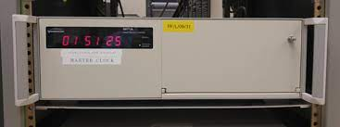
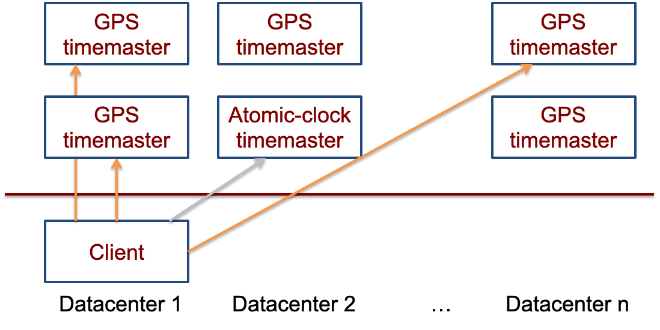
TrueTime adopts multiple time servers
Time servers are backed by GPS & atomic clocks
High-precision clocks
E.g., 1 second drift after 20,000,000 year (vs. 200us per second of CPU) (drift极低，因而可以近似认为不会drift，所以这时候就可以认为多个GPS server上的时间都是一致的而不需要额外的同步，因而与任何一个server去获取TrueTime都是一致的)
Atomic clocks are synchronized with each other

Slide 75
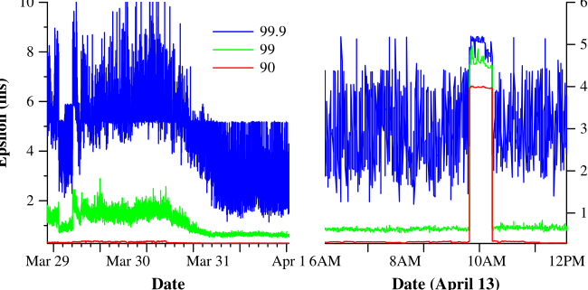
Final takeaway of TrueTime: Network-Induced Uncertainty
Interval of T
[ (T – tend) * (1 - ε) + tsrv, (T – tbegin) * (1 + ε) + tsrv]
tsrv – tbegin is rougly estimated as the network delay
Can have spikes if timemasters are out of services
一种测试分布式容错的方式：如右图，人为的crash几台server看看
系统运行起来是否正常且正确
Maintain 2 timemasters
tsrv
Server
delay
Client
tbegin
tend

Slide 76
Summary
Reify clock uncertainty in time APIs
Known unknowns are better than unknown unknowns
Rethink algorithms (TX’s concurrency control) to make use of uncertainty
Stronger semantics are achievable
Greater scale != weaker semantics

Slide 77
(Old)SQL
NoSQL

Slide 78


OldSQL = Relational Model + SQL + ACID
The architectural or historical ﻿baggage of SQL
Abstraction
Relational + Transaction
Semantic
ACID
Architecture
Mostly focus on Single-node & On-disk
Example
MySQL, PostgreSQL, etc.

Slide 79

The trend of Web and Big Data
Requirements
Scalability: Multiple concurrent users
Availability: Minimal User-down time
Read-mostly
Many data operations do not need transaction
Large dataset
Note: some requirements are compatible to the SQL (and that’s why there is NewSQL)

Slide 80
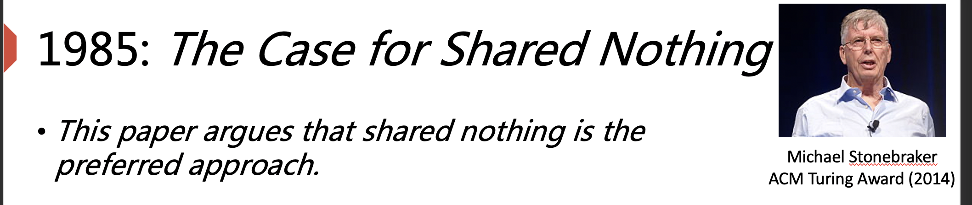
The Attempt for Scaling SQL
1986:
Building scale NoSQL DBMS on SQL☺
E.g., MySQL
SQL
Shared-nothing
SQL
SQL
SQL
Vertically
Horizontally
Build larger machine
Build distributed system with more machines
Notes:
Is it centralized?
Why difficult to support ﻿update more than one record in a transaction
Double query optimizer
Vertically: Using better hardware
Horizontally:
How to do that?
A middleware
Google Ebay
Only support simple operations

Slide 81


Scale Horizontally with Middleware (in old time)
App
App
Read/Write single Record
Middleware
SQL
SQL
SQL
No Distributed Transaction & Join
Unavailable in some scenarios
E.g., Server failover
Shard1
(1-33)
Shard2
(34-66)
Shard3
(67-100)
﻿eBay’s Oracle-based cluster[1]
Google’s MySQL-based cluster[2]
We should mention that we can actually support availability & distributed with techniques taught
[1] https://tuftsdev.github.io/WebEngineering/spring2017/notes/ebay2006.pdf
[2] https://storage.googleapis.com/pub-tools-public-publication-data/pdf/38125.pdf
Notes:
当年这些技术还没有广泛的应用。 后面我们会看到现代系统使用这些的实现

Slide 82
Scale Horizontally with Middleware
No distributed TX
No ACID properties
Cannot to implement AliPay
No join
Only support single read/write query
E.g., select * from xxx where ID = xxx;
Similar semantic as key-value store!
Why not provide join?
E.g., using nested loop to implement
Inefficient! DBMS has many opts
App
App
Middleware
SQL
SQL
SQL
Shard1
(1-33)
Shard2
(34-66)
Shard3
(67-100)
Not implemented that time.
But are now supported.

Slide 83

Implementing SQL scalably is challenging that time
2PL OCC MVCC 2PC Paxos, …
From SQL to query plan
Query planning & opt
Partitioning
Buffer management
……

Slide 84
The term “NoSQL”
First use in 1988[1], used to describe
An RDBMS not using SQL
Reintroduced in 2009[2], during the meetup for
Open-source distributed, non-relational databases
Why not implement SQL scalable, instead of building middleware in existing SQL-based system or propose new NoSQL systems?
[1] https://en.wikipedia.org/wiki/Strozzi_NoSQL
[2] https://web.archive.org/web/20110716174012/http://blog.sym-link.com/2009/05/12/nosql_2009.html
Notes:
SQL: standard query language
Unix shell

Slide 85
NoSQL - Build from scratch
How does NoSQL make trade off?
Specific (simplified) data model
Weaken Transaction
Async Replication
Reducing the complexity
e.g., distributed query plan,
join support, etc.
Sacrifice consistency for scalability & availability

Slide 86
1. Specific (Simplified from SQL) Data Model
All records can be found by simple lookup
Key-Value store
Document (key -> JSON)
Wide-Column Store
A table-oriented model
But its columns can vary from row to row in the same table
Why?
Easy to build from scratch, can focus on being more scalable!
E.g., no need to support complex query languages in SQL
key
Alice
key
Name: Alice, Age:10
Name, Age
Email
key
Alice,10
key
Alice@qq.com
Notes:
Kv -> redis
Document -> MongoDB
WSS -> BigTable

Slide 87
2. Weaken Transaction
Data is partitioned across different servers
Local TX: TX’s data only touches data on a single node
Global TX: otherwise
Local TX can leverage existing single machine techniques (2PL)
Global TX: no support for transactions
Local Transaction {
A = A + 1
B = B + 1
}
Global Transaction {
A = A + 1
C = C + 1
}
S1
A=0
B=0
S2
C=0
D=0
Notes:
Fun fact: chubby

Slide 88
Why weakening the Transaction?
Support global TX is hard & inefficient that time
2PL + 2PC + Paxos
Mature Paxos design dates back to 2006 (Chubby@OSDI’06)
Local Transaction {
A = A + 1
B = B + 1
}
Global Transaction {
A = A + 1
C = C + 1
}
S1
A=0
B=0
S2
C=0
D=0
Notes:
Fun fact: chubby

Slide 89
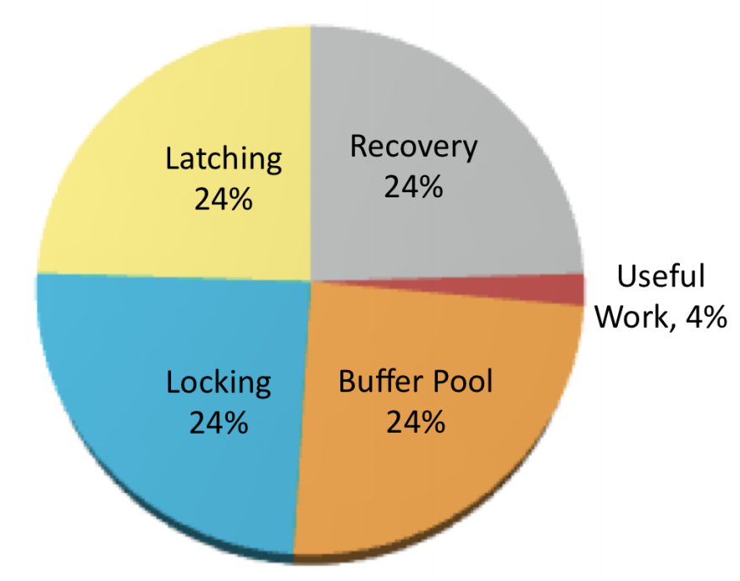
Why weakening the Transaction?
Huge software overheads introduced by ACID transactions
Due to the strong properties even we don’t consider high availability
OldSQL spends little time for useful work
Figure from slides presented
by Michael Stonebraker[1]
[1] https://www.usenix.org/legacy/events/lisa11/tech/slides/stonebraker.pdf

Slide 90

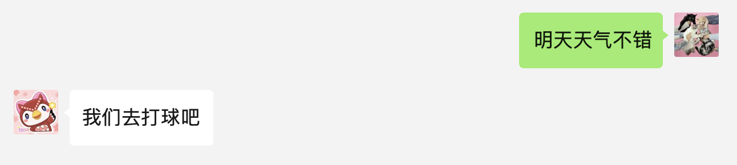
Drawback of weaken transaction
What may happen when weakening the transaction?
Can have incorrect results (anomalies)
Messages reorder
In several workloads, can tolerate such incorrect results
E.g., social network applications
WeChat on my Mac
WeChat on my iPhone

Slide 91
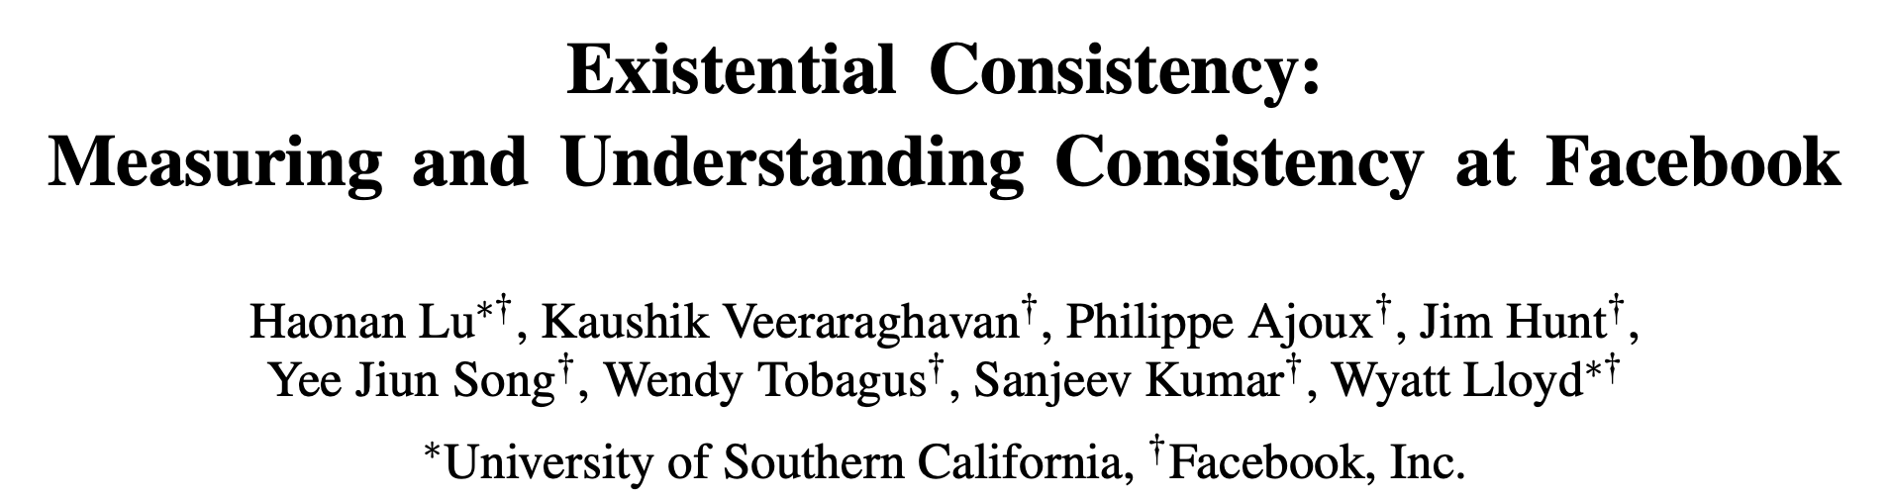
Several (NoSQL) applications can tolerate inconsistency
What may happen when weakening the transaction?
Can have incorrect results (anomalies)
In several workloads, can tolerate such incorrect results
E.g., social network applications (recall lecture 8, eventual consistency)
Facebook's reports: 1 anomaly per million reads

Slide 92

3. Asynchronous Replication
Replication is used for Availability
Synchronous
Wait for backup’s responses before return (e.g., Paxos or Primary backup)
Asynchronous
Only waits for the primary
Commit requires one more round-trip
Primary
Backup
Possible to lose data or read stale data
What are the trade-offs?
Primary
Backup

Slide 93
Summary of Several Famous NoSQL systems
NoSQL | Data Model | Replication | Transaction
BigTable (2005) | Wide-Column | Sync+Async | Local
Cassandra (2008) | Wide-Column | Async | Local
MongoDB (2009) | Document | Async | None
Redis (2009) | Key/value | Async | None
Dynamo (2012) | Key/value | Async | None
*Table data collected when these project first released

Slide 94
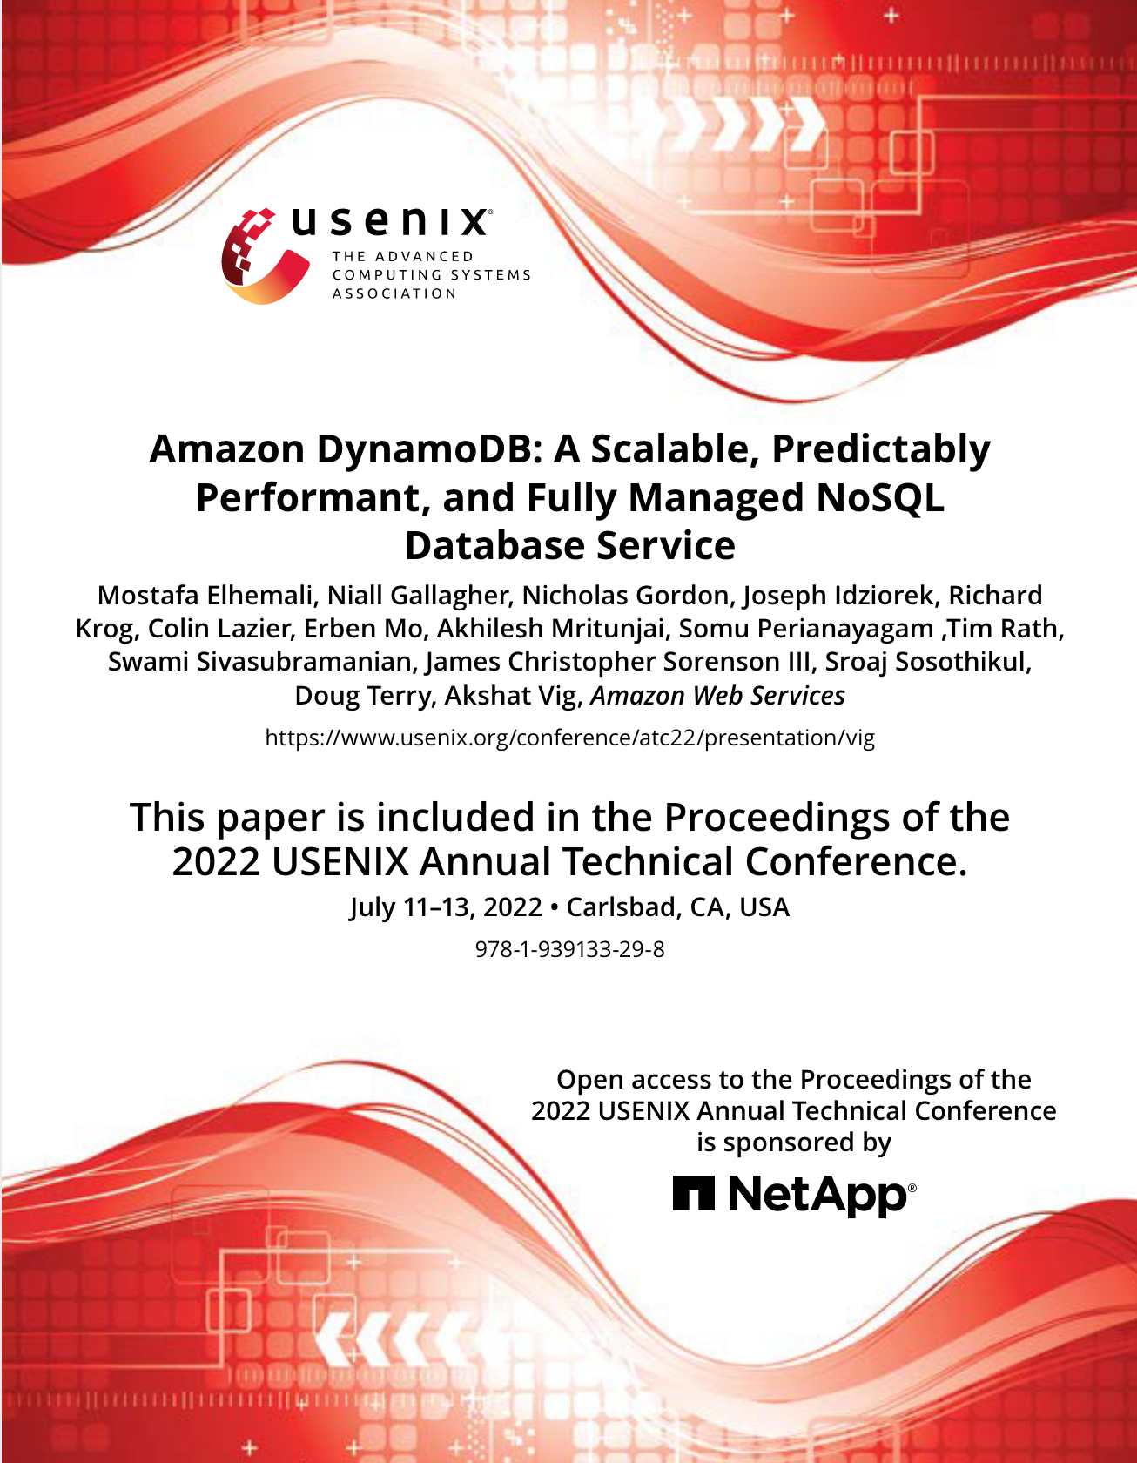
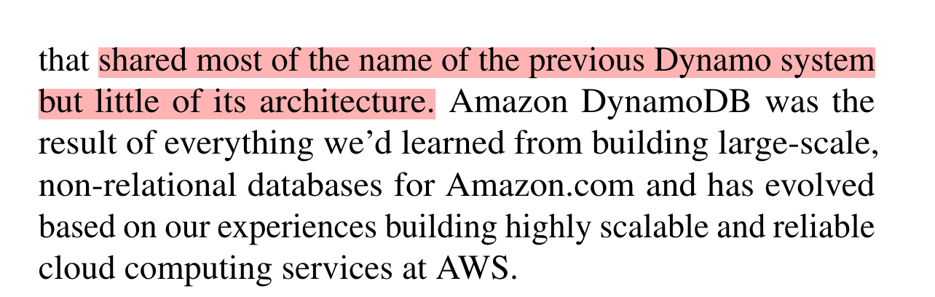
Fun fact about DynamoDB@2022
Use paxos to ensure replication consistency
i.e., no need for user to provide reconcile function
Also provides ACID transactions

Slide 95
NewSQL
A class of modern RDBMS, which provides:
NoSQL’s Scalability
SQL’s ACID Transaction & Relational Model
First proposed in 2011 [1]
“Children make choices, adults want them all.” ——Someone said
[1] Matt Aslett, “How will the database incumbents respond to NoSQL and NewSQL?”, 2011

Slide 96

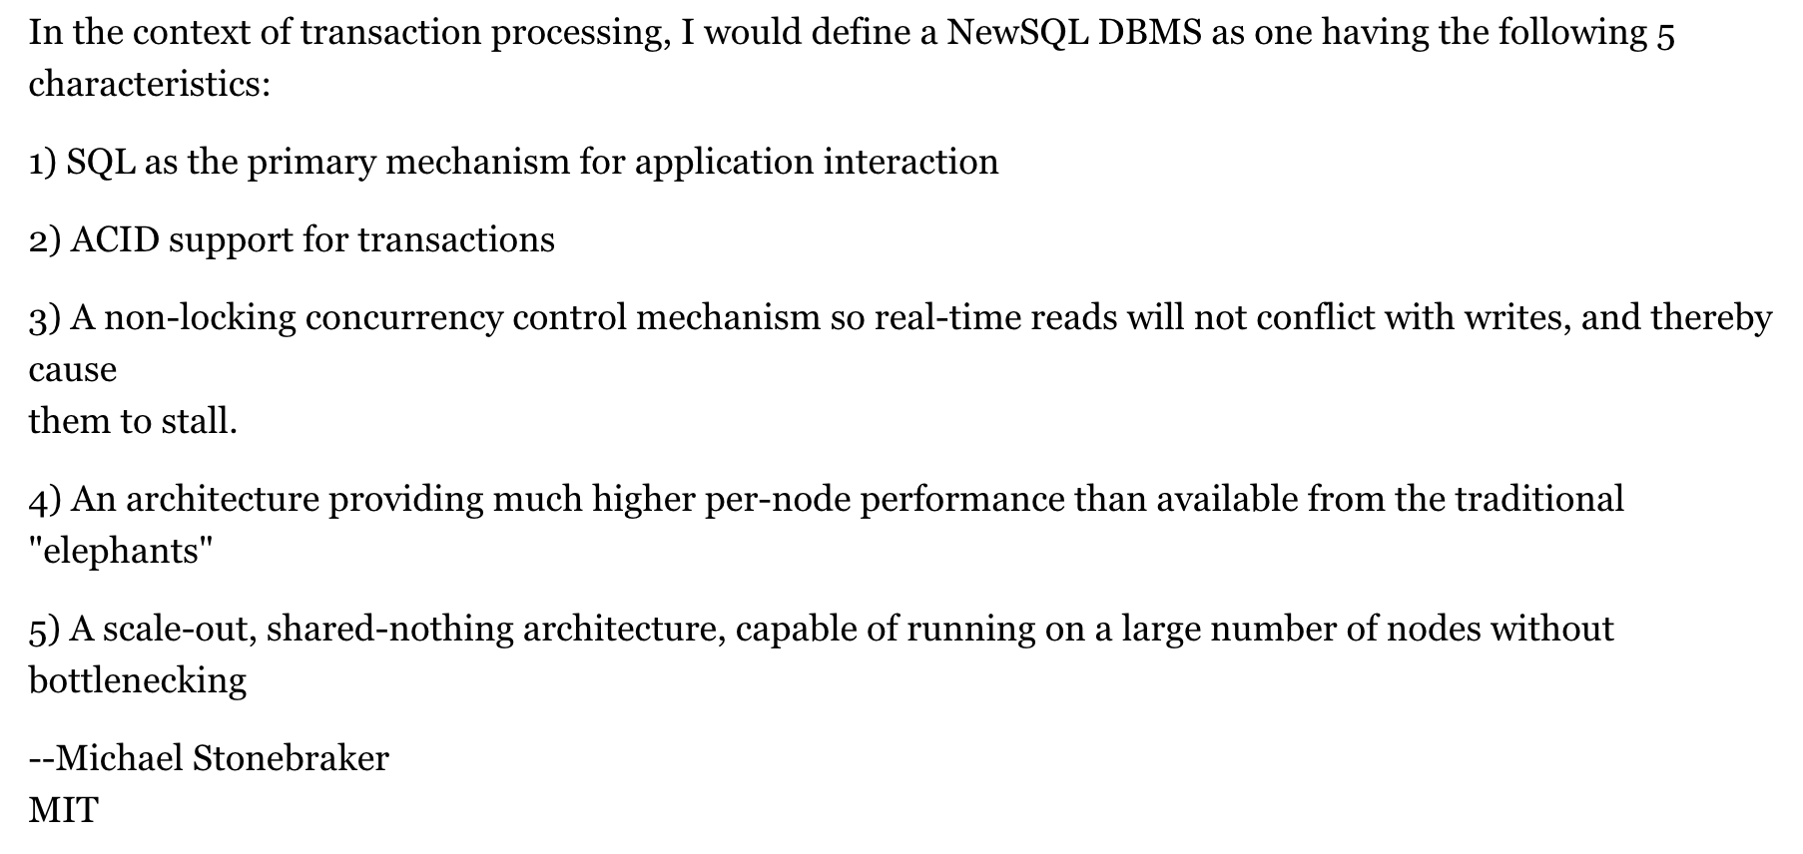

Stonebraker’s NewSQL definition[1]
Turing Award
2014
Michael Stonebraker
[1] https://cacm.acm.org/blogs/blog-cacm/109710-new-sql-an-alternative-to-nosql-and-old-sql-for-new-oltp-apps/fulltext
Notes:
non-locking这里指的是MVCC，即读不加锁

Slide 97
Summary SQL vs. NoSQL vs. NewSQL
A vague comparison (represents the majority)
The comparison is based on general principles, not actual systems
I.e., different systems may have different implementations, each with different trade-offs)
E.g., some NoSQL databases also implement ACID
 | Relational | ACID | Scalability | Availability | Performance | Example
(Old)SQL | ✓ | ✓ | ✗ | ✗ | Poor | MySQL
NoSQL | ✗ | Depends | ✓ | ✓ | Excellent | Dynamo
NewSQL | ✓ | ✓ | ✓ | ✓ | Good | Spanner
Notes:
很多干扰项， 比如language， etc

Slide 98
Summary SQL vs. NoSQL vs. NewSQL
Scalability
Ease of
programming
Performance
SQL
NoSQL
NewSQL
Consistency
Fault tolerance

